Slide 1

Programming One (csc7050)
Aidan McGowan
Methods – with a return

Slide 2
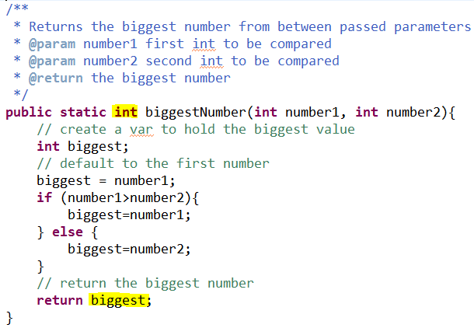
Return example
The declared return type
The return (needs to match the type declared above)

Slide 3
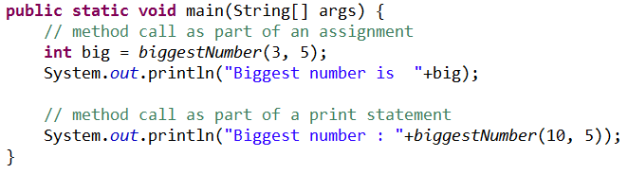

Invoking a method with a return type

Slide 4
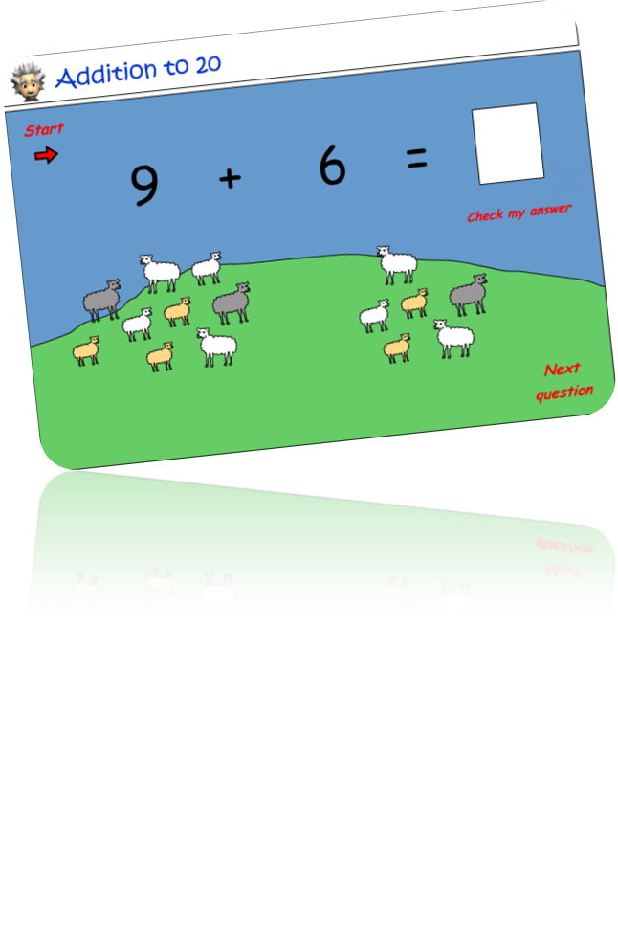
Exercise I - Method with a return
Create an application with a method that adds two numbers together. The result should be returned from the method and displayed …..
Notes:
/**
* Adds two passed parameter values together
* and returns the result.
* @param number1 first number
* @param number2 second number
* @return
*/
public static int add(int number1, int number2){
int answer;
answer = number1+number2;
return answer;
}
public static int add(int number1, int number2){
return number1+number2;
}

Slide 5
Returning a value from a method
A method returns to the code that invoked it when it
  completes all the statements in the method
  reaches a return statement
  throws an exception (covered later)
whichever occurs first.
You declare a method's return type in its method declaration.
Within the body of the method, you use the return statement to return the value.

Slide 6
Returning a value from a method
Any method declared void doesn't return a value. It does not need to contain a return statement
Any method that is not declared void must contain a return statement with a corresponding return value, like this:
  return returnValue;
The data type of the return value must match the method's declared return type; you can't return an int value from a method declared to return a boolean.

Slide 7

Exercise II - Method with a return
Create an application with a method that prompts the user for his / her full name. The name should be returned from the method and displayed …..
To input the name use :
Also deal with the user that decides not to enter any text.
Notes:
public static void main(String[] args) {
String userName;
userName = getUserName();
if (userName.length() == 0){
System.out.println("What, no name ?");
} else {
System.out.println("Hello "+userName);
}
}
/**
* Method prompts user for name and returns the inputted value as a string
* @return the user's input
*/
public static String getUserName(){
String userName=null;
Scanner scanner = new Scanner(System.in);
System.out.println("Enter your full name : ");
userName = scanner.nextLine();
scanner.close();
return userName;
}

Slide 8
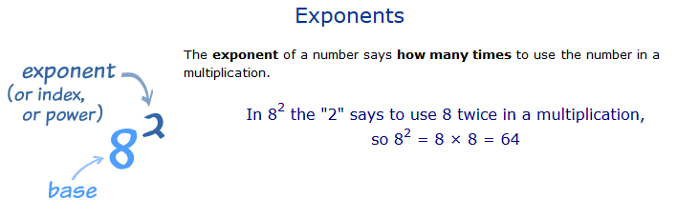
Exercise III - Method with a return
Create method that will use the Math.pow(double number, double exponent) to calculate a number multiplied a specified number of times by itself.
The number and exponent should be passed to the method as a parameter argument.
Notes:
public class ExponentCalculator {
public static void main(String[] args) {
System.out.println(exponentCalculation(3, 2));
}
public static double exponentCalculation(double number, double power){
return Math.pow(number, power) ;
}

